Slide 1


Slide 2




Slide 3

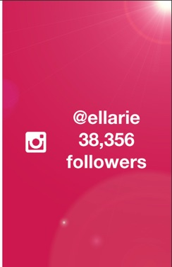
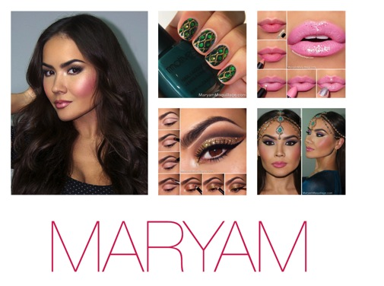
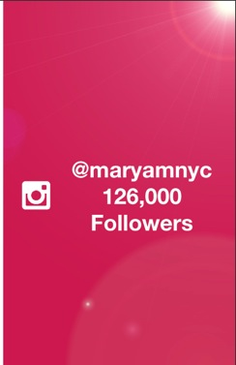

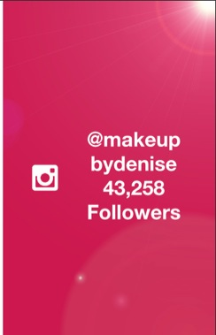

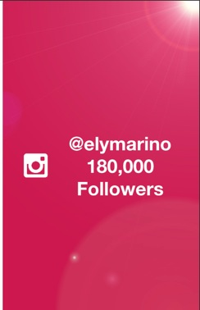

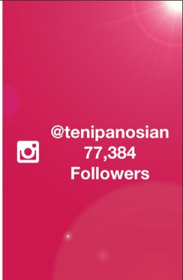
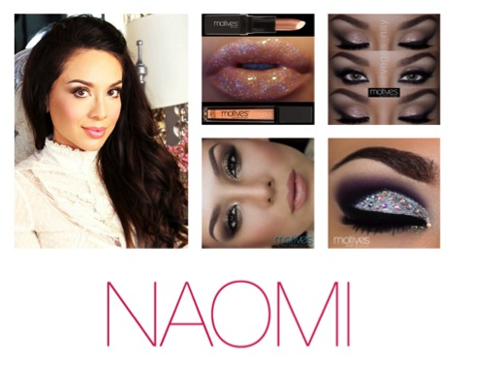
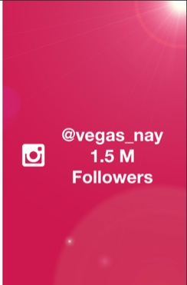

Slide 4

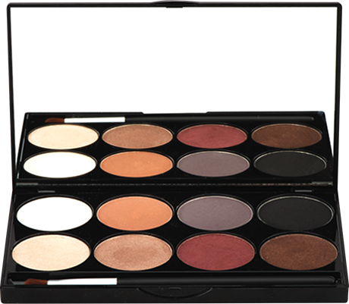

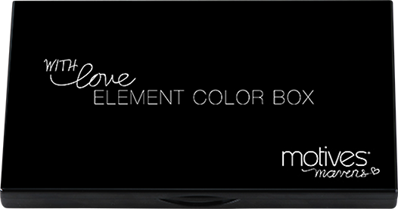
Motives® Mavens專業眼影組合
  Gorgeous “Element” Eye palette
  made with love
  by our beautiful Mavens
HK1LMR; DC$213.00; SR$298.00; BV: 15

Slide 5
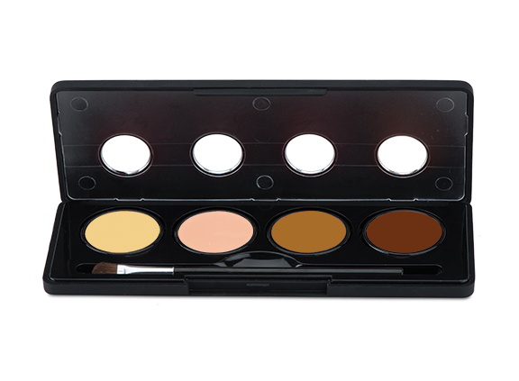
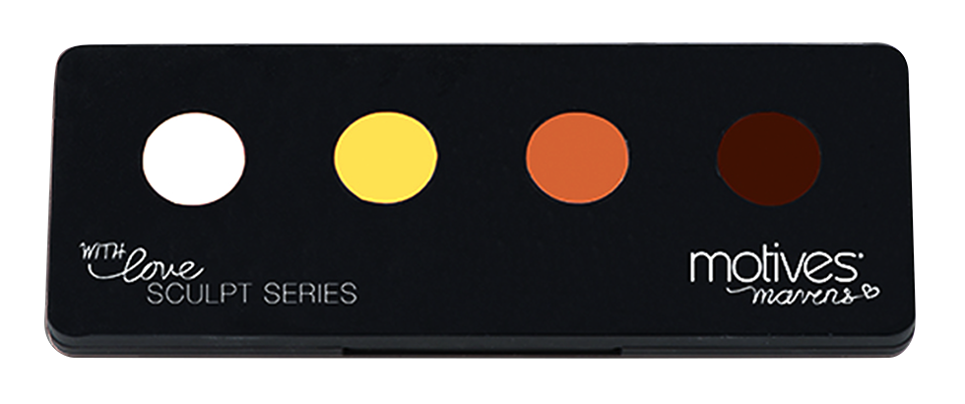
Motives® Mavens專業修容組合
  2 Sculpt Series Palettes – Ice & Fire
  made with love
  by our beautiful Mavens
DC$213.00; SR$298.00; BV: 15

Slide 6
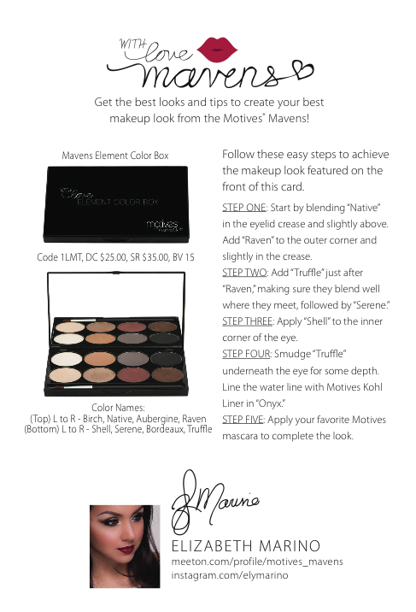
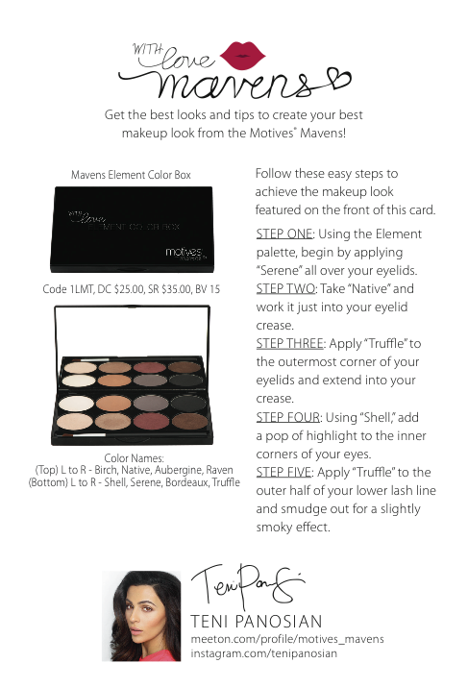
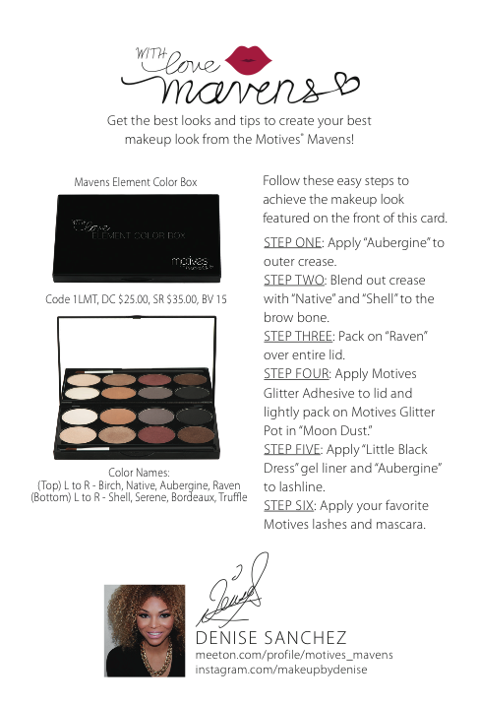
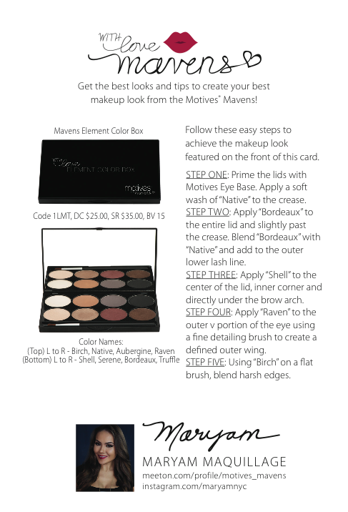

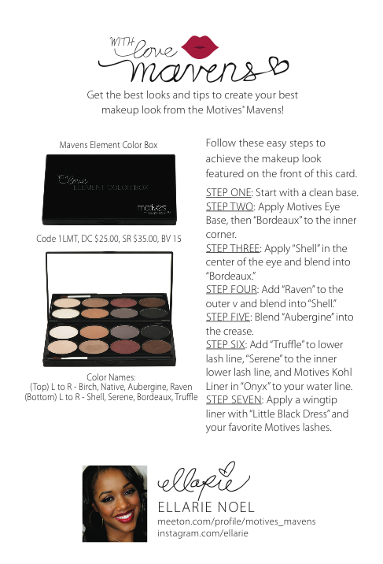
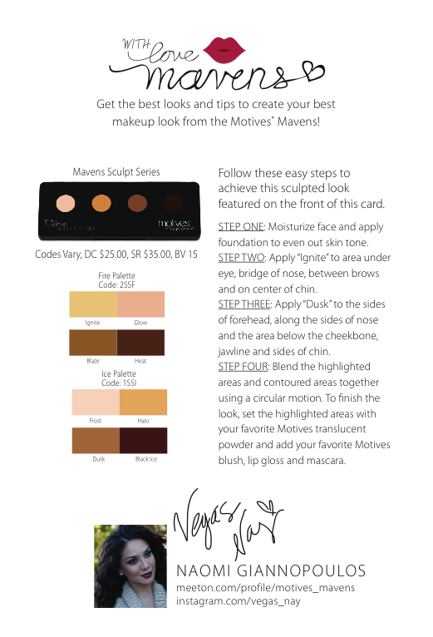

Slide 7




Slide 8
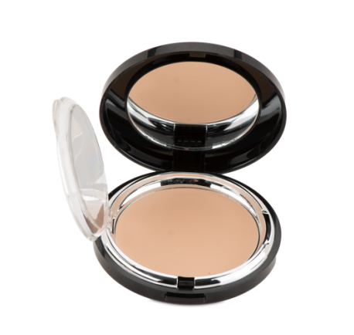
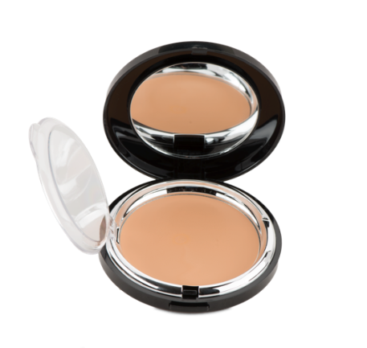
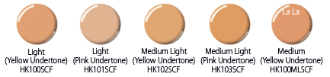
Motives® and Motives® for La La
無瑕美肌膏狀粉底
Supreme Crème Foundation
容易推開的膏狀配方可塗上多層以達不同遮瑕效果，而且顏色持久不變
防皺摺配方，為肌膚提供保濕及滋潤
An easy-to-blend crème formula; Provides buildable, even coverage that stays true-to-color
Crease-resistant formula that moisturizes and conditions the skin
DC$152.00; SR$213.00; BV: 15

Slide 9

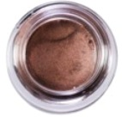


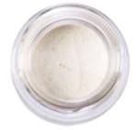
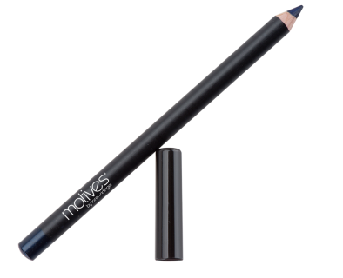

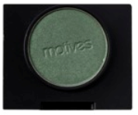
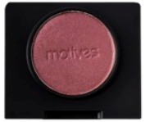
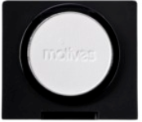
Motives®一眼部產品
Products for Eye
Motives®瑰麗眼影膏
Luxe Crème Eye Shadow
DC$119.00; SR$167.00; BV: 9.50
Motives®礦物防水眉筆
Mineral Waterproof Eyebrow Pencil
DC$101.00; SR$142.00; BV: 8
Motives®眼影
Pressed Eye Shadow
DC$95.00; SR$133.00; BV: 7.50
Motives®柔滑眼線筆
Khol Eyeliner
DC$96.00; SR$133.00; BV: 8.50
La La: DC$97.00; SR$136.00; BV: 8.50
Motives® for La La 礦物柔滑眼線筆 Khol Eyeliner
DC$97.00; SR$136.00; BV: 8.50

Slide 10
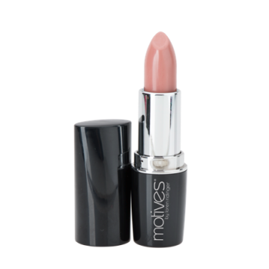
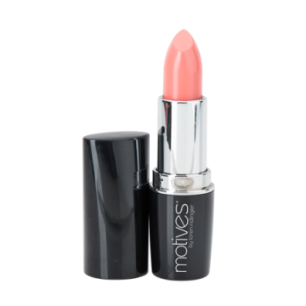
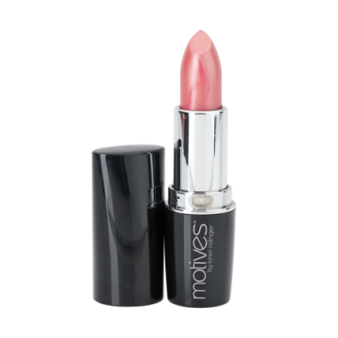

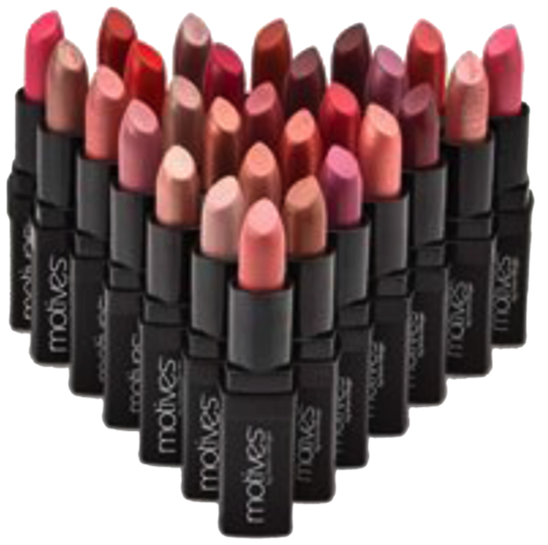
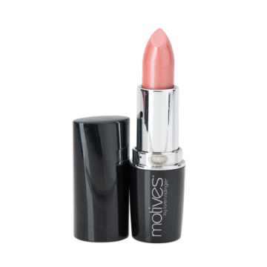
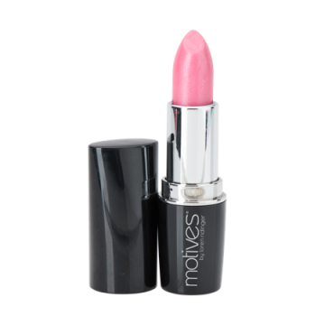
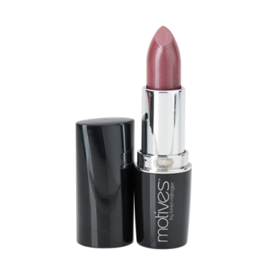
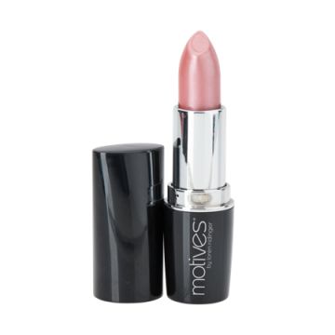
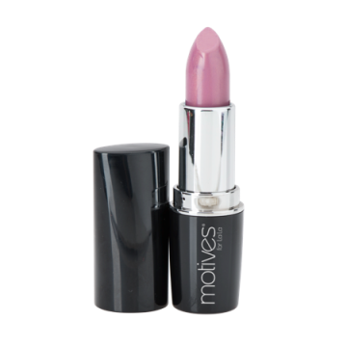
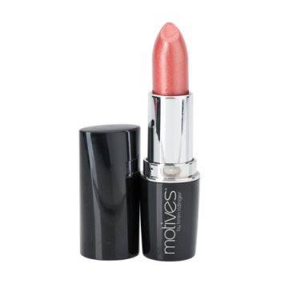
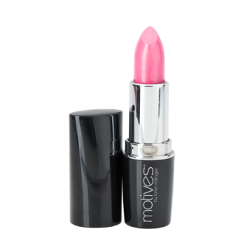
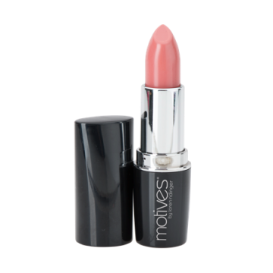
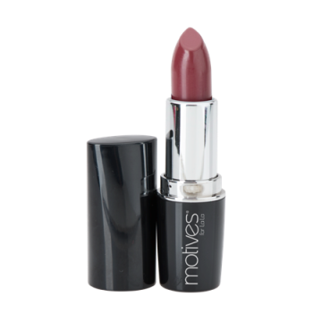
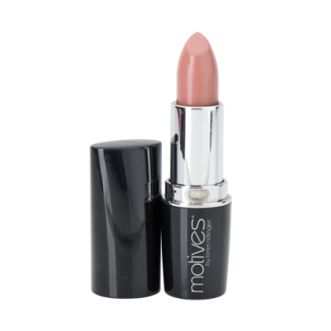
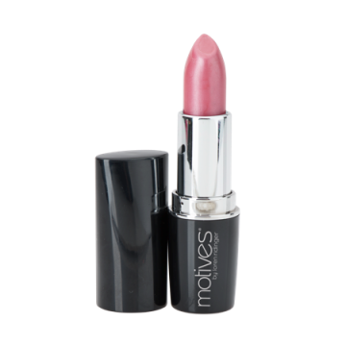
Motives® &
Motives® for La La 水漾唇膏
Moisture Rich Lipstick
Motives®礦物唇膏
Mineral Lipsticks
DC$102.00; SR$142.00; BV: 9
DC$110.00; SR$155.00; BV: 9.50

Slide 11
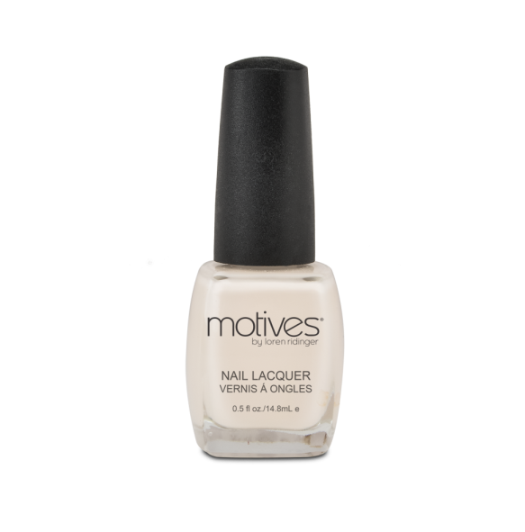
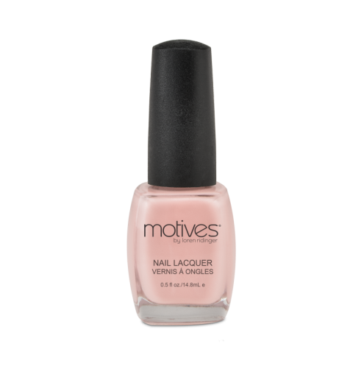
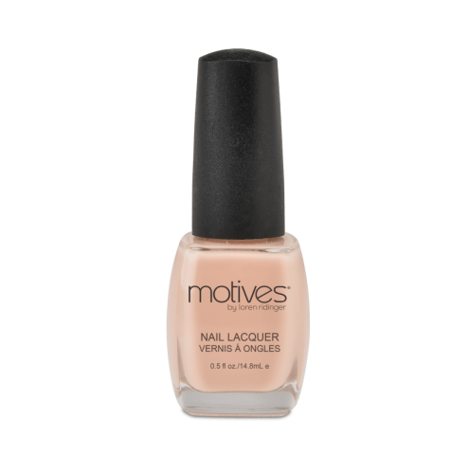
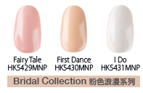
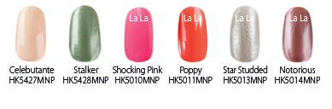
Motives®持久絕色甲油
Nail Lacquers
色澤持久
色澤亮麗，上色後不乾裂
可輕易順滑塗上
不含甲苯、甲醛和磷苯二甲酸二丁酯
Long-lasting color
Brilliant, chip-resistant finish
Easy, smooth application
Free of toluene, formaldehyde and dibutyl phthalate
DC$50.00; SR$70.00; BV: 3.50

Slide 12


Motives®持久絕色甲油組合
Nail Lacquer Kits
時尚組合
Nail Lacquer Kit
仲夏組合－限量套裝
Summer Essential Kit –
Limited Quantity
DC$225.00; SR$315.00; BV: 15.75
DC$225.00; SR$315.00; BV: 14.50

Slide 13

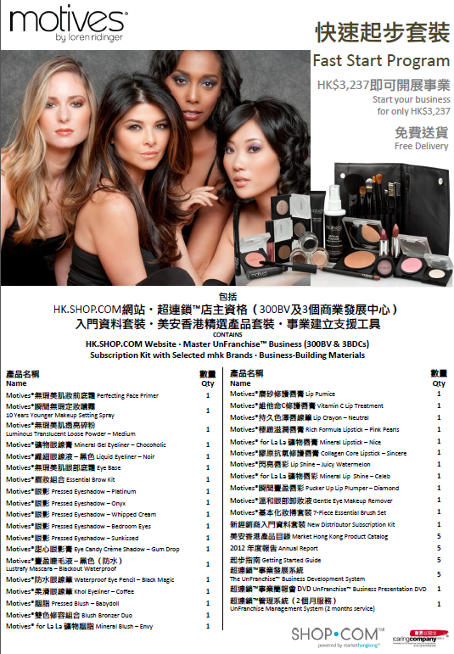
快速起步套裝
Fast Start Program

Slide 14
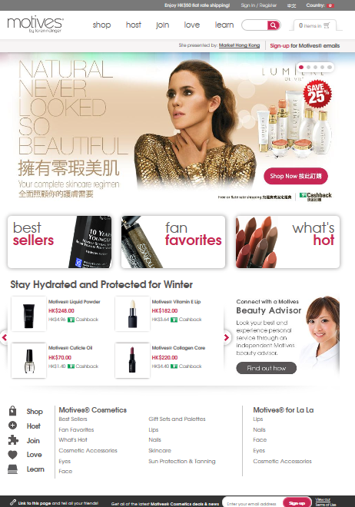
Motives® 網站
Cosmetics
Website

Slide 15
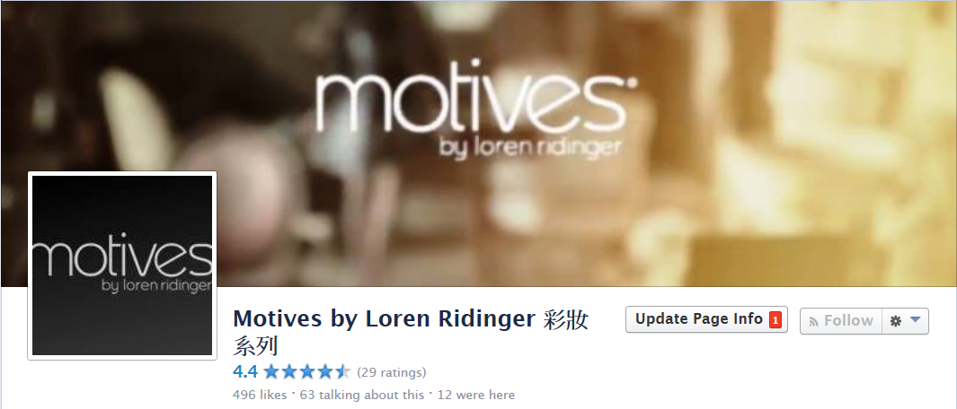



緊貼Motives by Loren Ridinger系列最新資訊
Stay Connected with Motives by Loren Ridinger https://www.facebook.com/motivesmhk

Slide 16
特別鳴謝 Special Thanks To
MODELS:
Tsz Chan, Christopher Cheung, Sally Lam, Rex Leung, Miko Yip, Kwok Yiu
MAKEUP STYLISTS:
Angie Chou, Fanny Cheung, Sharon Lam, Chloe Leung, Helen Lin, Co Co Ng
HAIR STYLIST:
Pat Chan
PHOTOGRAPHER / POST PRODUCTION:
Kirk Kwok
ASSISTANT:
Yuen Yuen Leung
MOTIVES CERTIFIED TRAINERS:
Angie Chou, Helen Lin, Asa Ng, Angela Smith, Maggie Su, Rose Wong

Slide 17

嶄新的公司，嶄新的機會，嶄新的你
2014美安香港年會
mhk Annual Convention
#MHKAC2014

